Slide 1
Scaling Learning to Rank to Big data
A study concerning the parallelisation of learning to rank algorithms using the mapreduce computing model

Slide 2
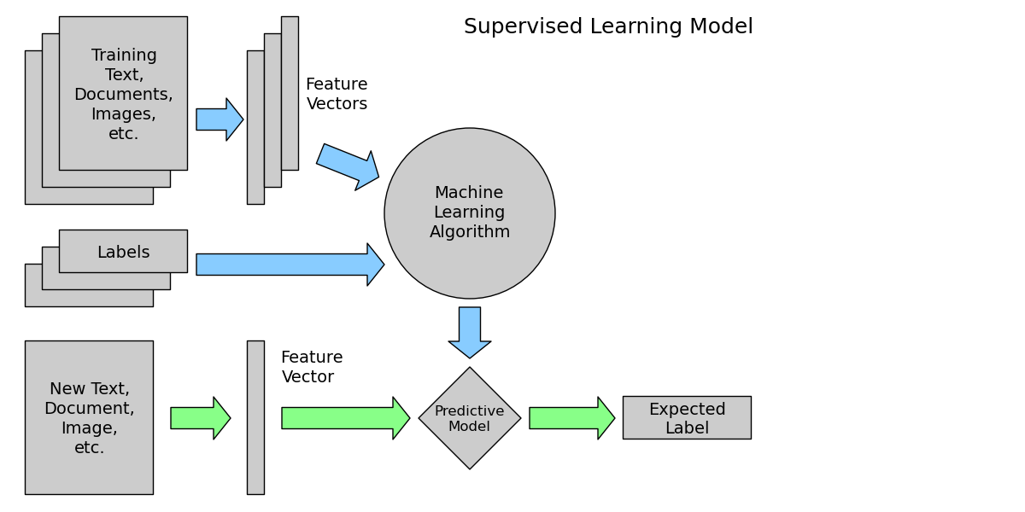

Slide 3
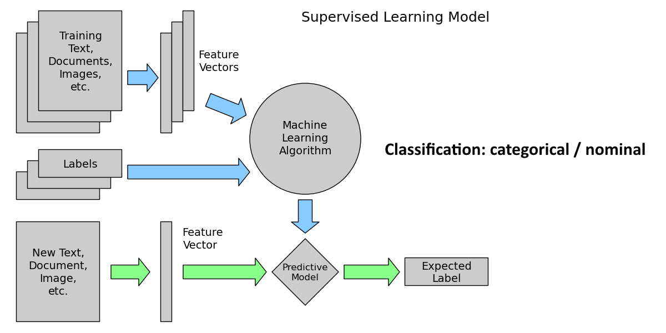

Slide 4
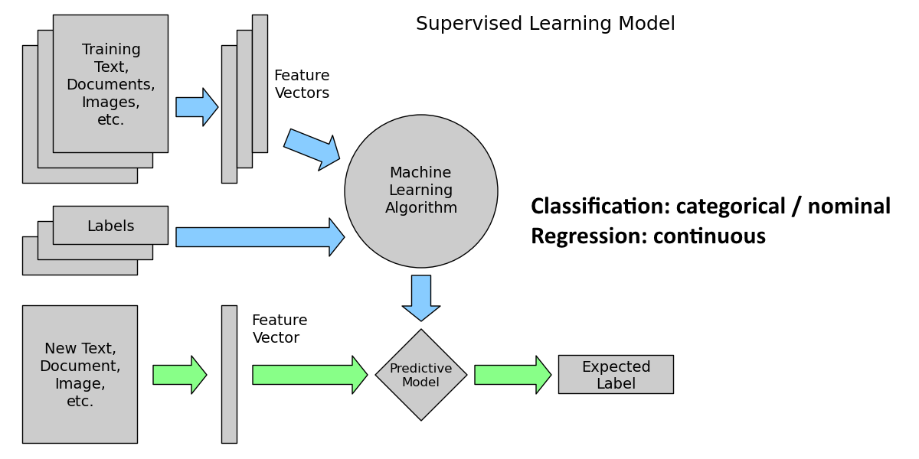

Slide 5


Slide 6


Slide 7


Slide 8


Slide 9


Slide 10


Slide 11


Slide 12



So… what makes a good ranking?
Normalized Discounted Cumulative Gain
Highly relevant documents are more useful than marginally relevant documents
Highly relevant documents are more useful when appearing higher in a search engine result list

Slide 13
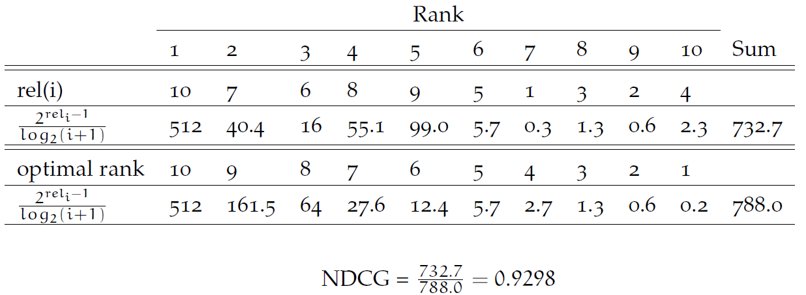
NDCG, an example calculation

Slide 14
Research questions
RQ1 What are the best performing Learning to Rank algorithms in terms of ranking accuracy on relevant benchmark data sets?
RQ2 What is the speed-up of those Learning to Rank algorithms when executed using the MapReduce framework?

Slide 15


Many Benchmark datasets
LETOR 2.0
LETOR 3.0
LETOR 4.0
MSLR-web10/30k
Yahoo! Learning to Rank Challenge
Yandex Internet Mathematics Competition 2009
WCL2R
AOL

Slide 16
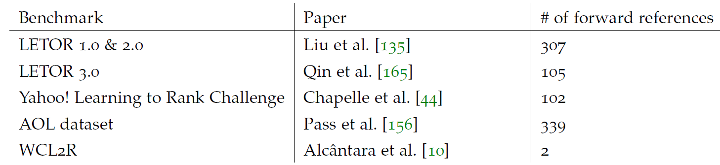
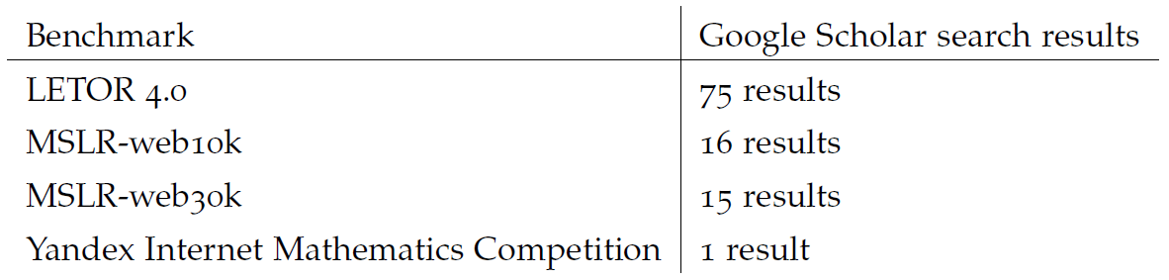
Search results

Slide 17
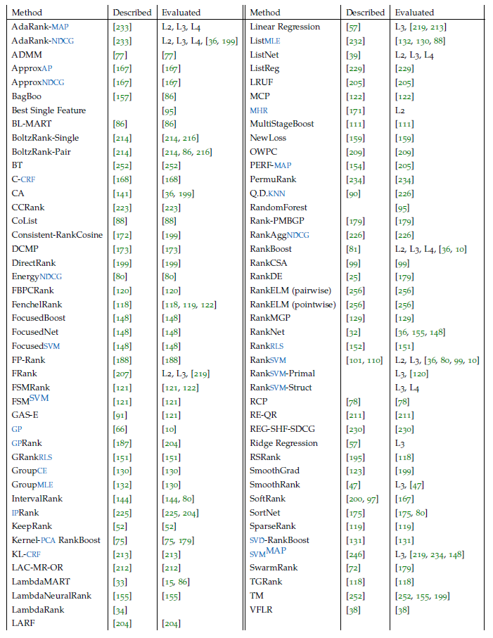

Slide 18
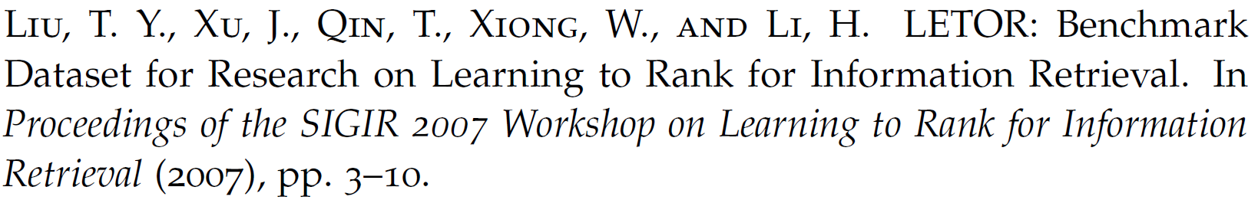
Comparison methodology
Winning Number (Liu et al., 2007)
Winning Number adapted for sparse evaluation sets:
Ideal Winning Number
Normalized Winning Number

Slide 19
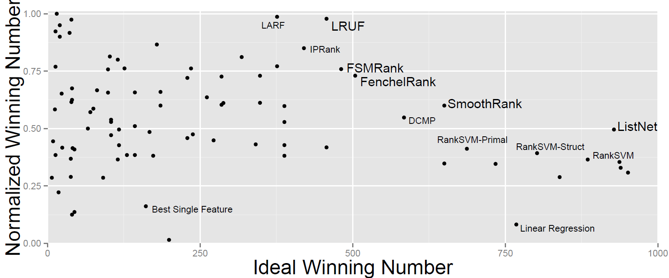
Comparison results

Slide 20
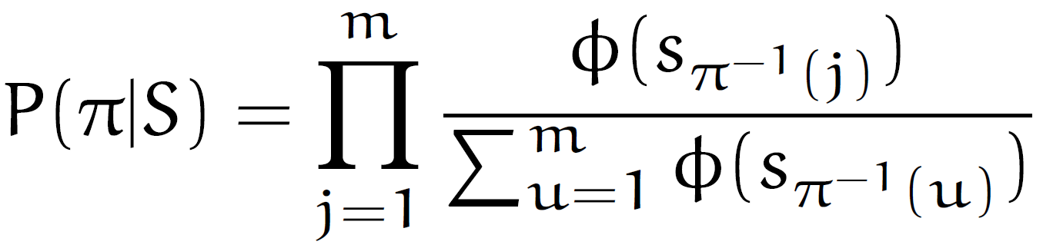
ListNet
Placket-Luce distribution:

Slide 21
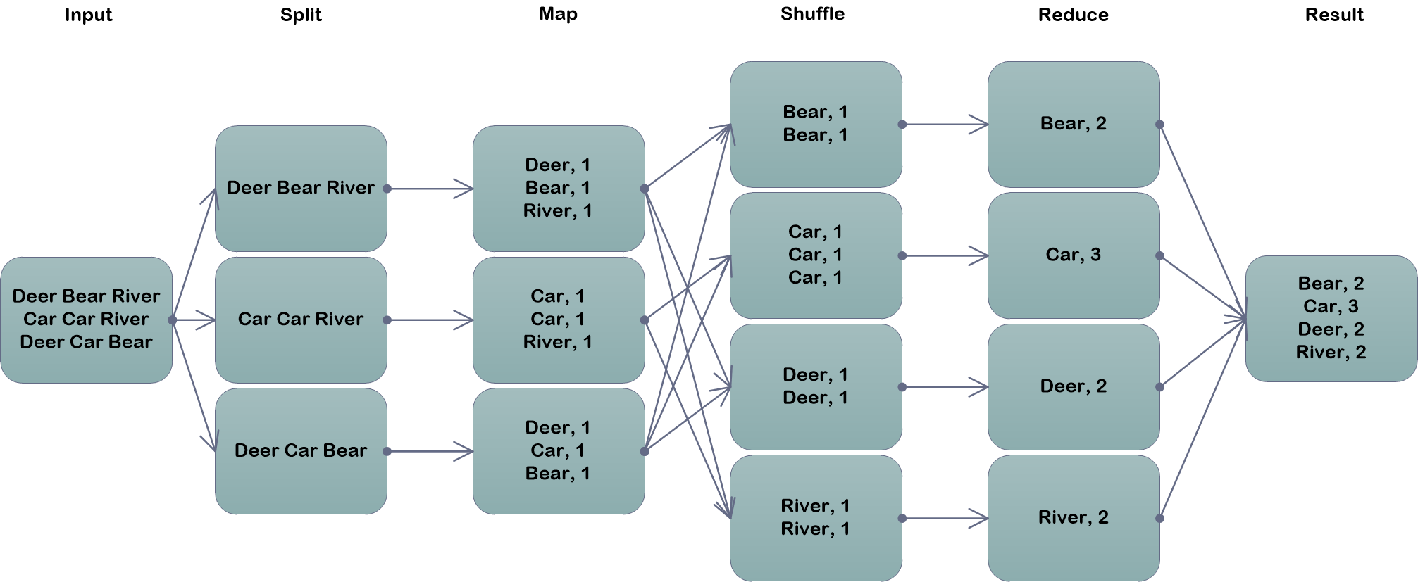
MapReduce

Slide 22
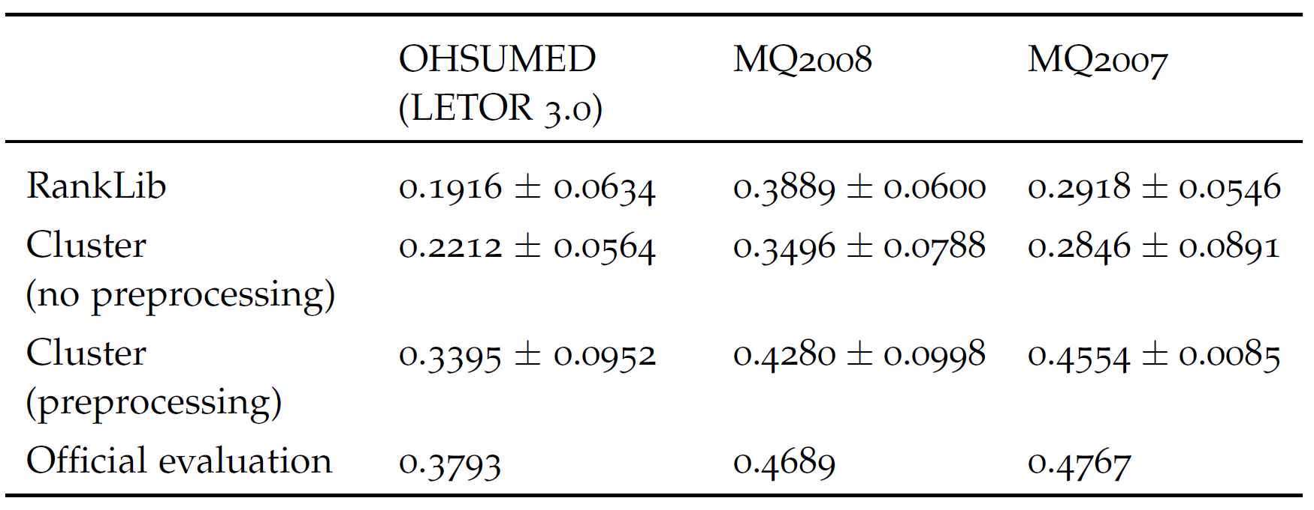
Preprocessing

Slide 23
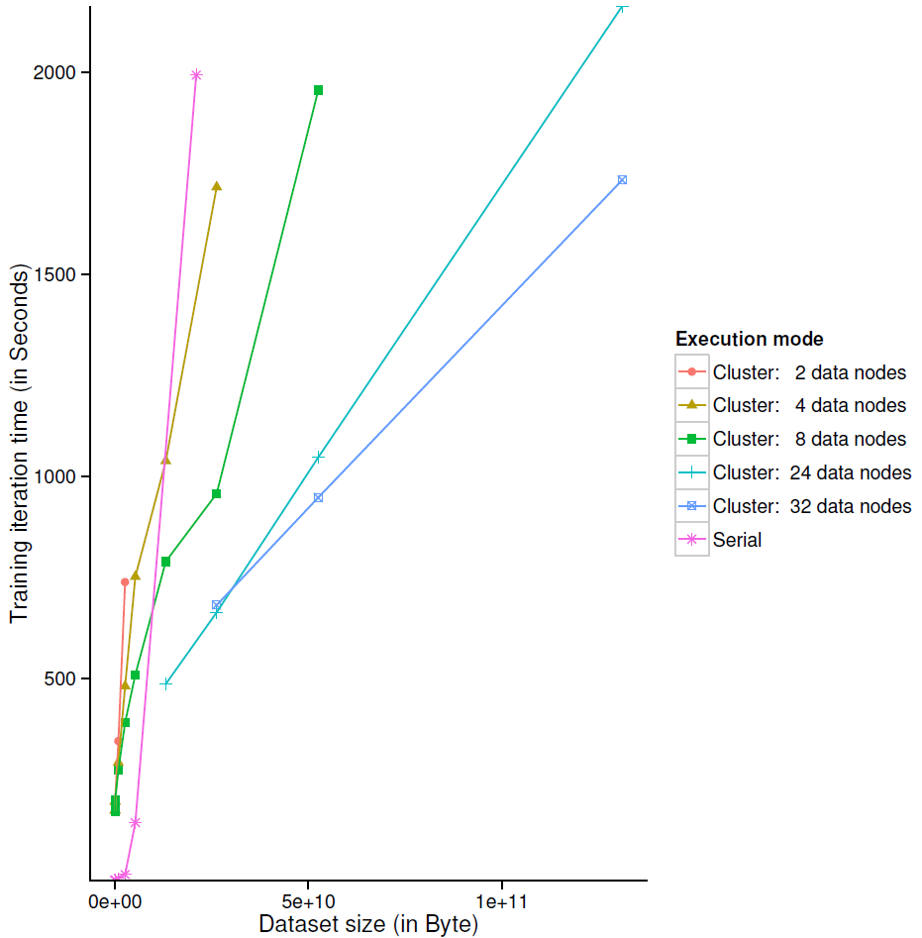

Slide 24
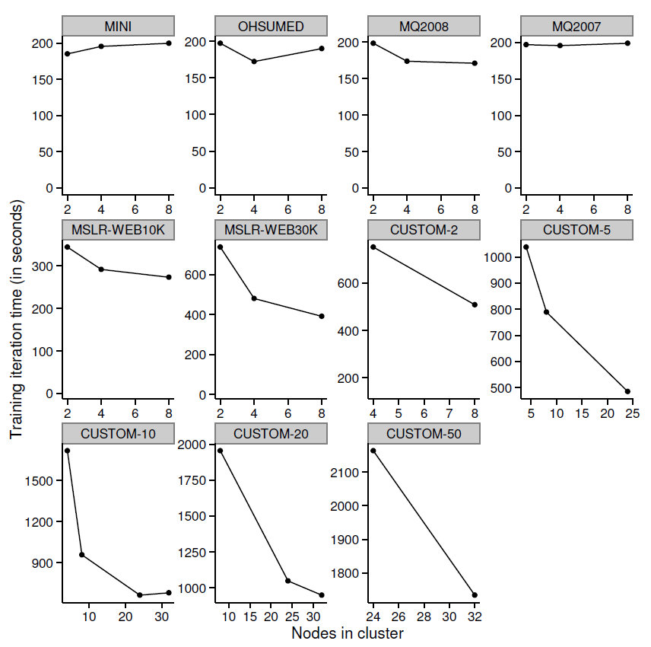

Slide 25
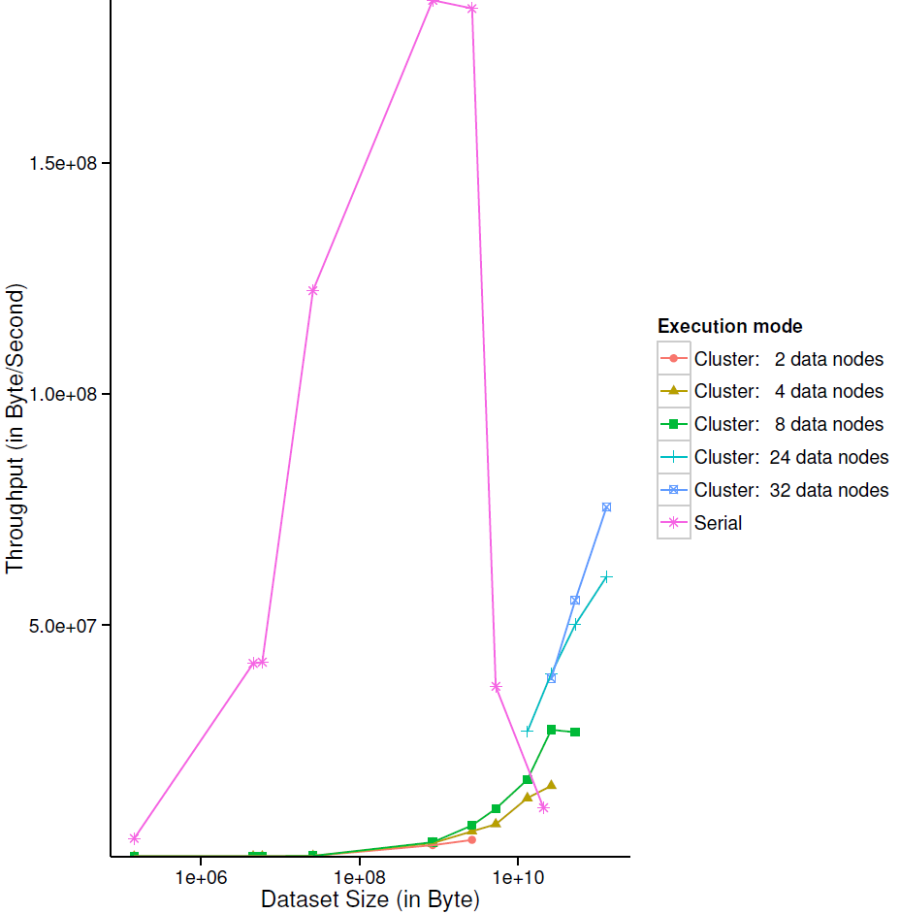

Slide 26
Conclusions & Contributions
New ranking algorithms comparison methodology
We found LRUF, FSMRank, FenchelRank, SmoothRank and ListNet to be the dominating Learning to Rank methods
High MapReduce job scheduling overhead: 150-200 seconds per iteration
Job scheduling overhead is independent of data set size
Single-machine ListNet does not scale well to data sets larger than physical memory
MapReduce can increase processing speed of data sets larger than physical memory
A normalisation preprocessing step improves the convergence rate of ListNet

Slide 27
Future work
Distributed computing models
Learning to Rank algorithms
Optimisation algorithms

